Slide 1
The Pathway from Priest to Predator
Presented by
Robert Crawford, EdD, MS, LPC, NCC

Slide 2
For Today’s Opportunity to Present a special thanks to……
Rod J Herrera
Director, Office of Child & Youth Protection
Diocese of Camden
And
Barbara Ann Gondek
Victim Assistance Coordinator
Diocese of Camden

Slide 3
The Pathway from Priest to Predator
Welcome……
We are told that ….”the Truth Hurts…..
“We must no longer be children, tossed to and fro and blown about by every wind of doctrine, by people’s trickery, by their craftiness in deceitful scheming. ¹⁵ But speaking the truth in love, we must grow up in every way into him who is the head, into Christ” Ephesians 4:14-15 (NRSVCE)

Slide 4
Today’s Terms
“Clergy Offender” - with apologies offered and the intent not to diminish or disrespect a person’s standing within the Church,this term is intended to be gender non-biased and shall be used to refer to both ordained and non-ordained, men and women, priests, nuns, brothers, religious, as well as any ordinary of the Church.
“Vulnerables” - again, with apologies offered and the intent not to diminish or disrespect an individual’s personhood, this term shall be used to refer to all individuals, regardless of gender, age, race, sexual orientation, etc who are sexually, emotionally or otherwise victimized by the “Clergy Offender”.

Slide 5
The Pathway from Priest to Predator
And then let us begin….
1.) Really- Who does this sort of thing?
2.) Really- Who Protects or Denies about this sort of thing?

Slide 6
“Intimate” comes from Latin “intimus,” meaning “most personal, profound” or “inmost, innermost, most intimate”
(Attachment)
(Empathy)
Intimacy
Safety Vulnerability
(transparency & credibility)

Slide 7
The Key to Understanding the Destructive Power of Sexual Abuse upon the Vulnerable is to Understand “INTIMACY”
Safety
Vulnerability

Slide 8
The Key to Understanding the Destructive Power of Sexual Abuse upon the Vulnerable is to Understand “INTIMACY”
Vulnerability
Safety
The groomed child or teen demonstrates a form of vulnerability
The Predator manipulates after discovering this vulnerability and initially presents as caring, responsive, understanding
The groomed child or teen receives what in appearance is the security, affection, attention etc this is perceived by the vulnerable child or teen as proof of the adult’s safety…..but this is an intended deception of safety and soon in return for the their vulnerabilities being perceived as protected the vulnerable are gradually exploited often into a “quid pro quo” relationship for the Predator’s sexual and psychological need fulfilment. And the vulnerable child or teen is now trapped and victimized.

Slide 9
The Key to Understanding the Destructive Power of Sexual Abuse upon the Vulnerable is to Understand “INTIMACY”
Safety
Vulnerability

Slide 10
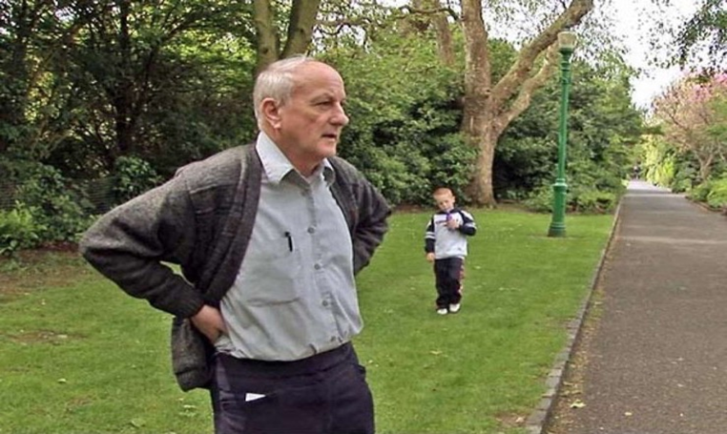
Really- Who does this sort of thing?
Q- Is this a crisis caused by Homosexuality?
Q- Is Celibacy that cause of this crisis?
Q-Is it caused by Pornography and Sexual Addiction?
Q- What is new vulnerable population emerging for the clergy offender?
Q- So, what do we “know” about the Clergy Offender?

Slide 11
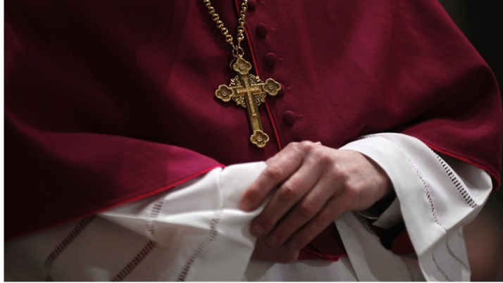
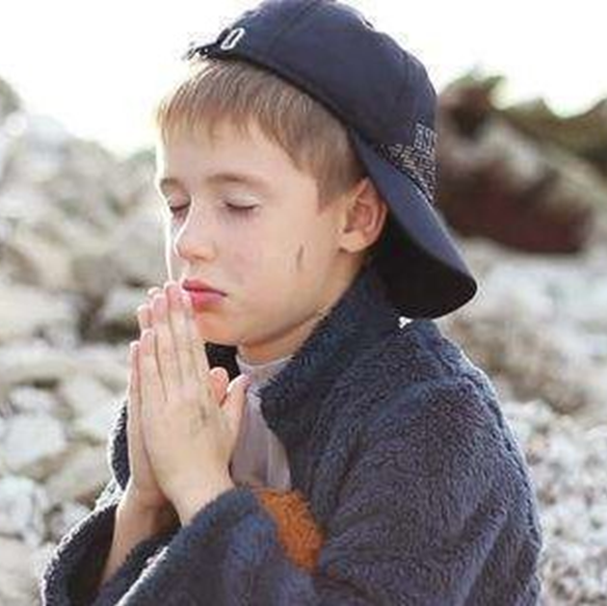

Slide 12
Is this a crisis caused by Homosexulaity?
8 in 10 of victims have been boys, but the idea that the abuse is related to homosexual men in the priesthood has not been widely accepted by Church leaders. The influential report of the John Jay College of Criminal Justice on the causes and context of Catholic clergy sex abuse concluded that widespread American abuse was not related to the share of homosexual priests because the reported increase in “homosexual men in the seminaries in the 1980s …does not correspond to an increase in the number of boys who were abused.”
However……. A reexamination of this data from the 1980’s thru 2002 yields a starting new conclusion. Examining the evidence of clergy sexual abuse by victim gender, age against the clergy’s sexual orientation….the new data reveals an almost statistically perfect correlation between the increase and decrease of homosexual men in the priesthood and the age, gender and number of the victims…….and there is an answer….stay tuned! (Hint….its not sexual orientation)

Slide 13
Pornography and Child Sexual Abuse
The word “pornography” is from the Greek words porne (prostitute) and graphos (to write or to record). So, in other words, pornography means “writing about prostitutes
Research gathered over the past few decades demonstrates that pornography contributes to sexual assault, including rape and the molestation of children.-
Pornography is considered not a “cause” but an “Accelerant” or “Rehearsal”
Child molesters often use pornography to seduce their prey, to lower the inhibitions of the victim, and to serve as an instruction manual.
It is a general research-based conclusion not pornography is not a stagnant practice but neuro/bio/social accelerant that will lead the user downwards into 1 of 3 pathways; misogyny, fetish perversions, or younger children

Slide 14
What really is Child sexual Pornography?
63% of child porn involves children under 8
78% involves children under 12
When Toddlers were the subject of the pornography, 60%
69% of backgrounds appeared to be the child’s home environment
54% of the videos involved adults assaulting the child or toddler
As the age of the children decreases, the sexual abuse and sexual exploitation acts become more intrusive. When babies and toddlers were seen in child sexual abuse material, 59.72% of abuse acts involved explicit sexual activity/assaults and extreme sexual assaults against the child.

Slide 15
Where does it Now Begin? Pornography
There has been a 774% increase between 2005 and 2011 in the number of child pornography images and videos reviewed through the National Center for Missing and Exploited Children’s Child Victim Identification Program.
More than 30% of the searches conducted in eDonkey P2P network are related to child sexual abuse
25% of all daily Internet searches are pornographic related totaling approx. 68 million searches per day
There are approximately 116,000 daily searches for “child pornography”
Average age children receive their first smart phone? 10 years old
Most common device porn is viewed? Smart Phones (61%)
Average age children first watch porn? 10 years old
And what day of the week has the highest online porn activity? Sunday!

Slide 16
Where does it Now Begin? Pornography
What mental health experts have learned is that when someone (90% of the offenders are male) becomes addicted to child pornography, they usually progress to younger and younger children and will seek out more sadistic or masochistic images, and in extreme cases, bestiality. ²
The Association for the Treatment of Sexual Abusers found that the average number of victims for non-incestuous pedophiles who molest girls is 20, for pedophiles who prefer boys the number jumps to 100.
An average serial child molester may have as many as 400 victims in his lifetime.
In a study by the National Center for Missing and Exploited Children of the people arrested for child pornography; 40% also had raped children along with possessing child pornography.
Child pornography is one of the fastest growing crimes in the United States right now. Nationally, there has been a 2500% increase in arrests in the past10 years, according to the FBI.

Slide 17
What really is Child sexual Pornography?
63% of child porn involves children under 8
78% involves children under 12
When Toddlers were the subject of the pornography, 60%
69% of backgrounds appeared to be the child’s home environment
54% of the videos involved adults assaulting the child or toddler
As the age of the children decreases, the sexual abuse and sexual exploitation acts become more intrusive. When babies and toddlers were seen in child sexual abuse material, 59.72% of abuse acts involved explicit sexual activity/assaults and extreme sexual assaults against the child.

Slide 18
Where does it Now Begin? Pornography
What mental health experts have learned is that when someone (90% of the offenders are male) becomes addicted to child pornography, they usually progress to younger and younger children and will seek out more sadistic or masochistic images, and in extreme cases, bestiality. ²
The Association for the Treatment of Sexual Abusers found that the average number of victims for non-incestuous pedophiles who molest girls is 20, for pedophiles who prefer boys the number jumps to 100.
An average serial child molester may have as many as 400 victims in his lifetime.
In a study by the National Center for Missing and Exploited Children of the people arrested for child pornography; 40% also had raped children along with possessing child pornography.
Child pornography is one of the fastest growing crimes in the United States right now. Nationally, there has been a 2500% increase in arrests in the past10 years, according to the FBI.

Slide 19
What is a Paraphila?
Paraphilias= Greek for “para” faulty or abnormal
Greek for “ philios” dear or friendly
So paraphilia can be understood as my “Abnormal friend”
Interestingly, the origin of the word “intimate” comes from “intimus” which is translated as “close friend”).
not every offender's sexually deviant behavior is driven by a paraphilic sexual arousal pattern, and sexually violent behavior, such as child molestation or rape, is not indicative that a paraphilic arousal pattern is the cause of the behavior.
the evidence that a substantial proportion of sex offenses are not a manifestation of a paraphilic arousal pattern.

Slide 20
What are the Nine Paraphilias?
1. exhibitionism ((exposure of genitals to strangers) 2. fetishism (use of inanimate objects)
3. Frotteurism (touching, rubbing against a nonconsenting person)
4. Pedophilia (sexualization of children)
5. sexual masochism (being humiliated or forced to suffer)
6. sexual sadism (inflicting humiliation or suffering)
7. transvestic fetishism (sexually arousing cross-dressing)
8. voyeurism (observing private activities of unaware victims)
9. Other Specified Paraphilic Disorder (paraphilias not falling into the already named diagnoses)

Slide 21
The 4 Forms of Pedophilia
1. Gerontophilia – being sexually attracted to the elderly
2. Ephebophilia or hebephilia – being sexually attracted to adolescents (from puberty thru teenage years to age of consent)…..Lolita syndrome/ Pederasty
3. Pedophilia – being sexually attracted to pre-pubescent /pre-orgasmic child
4. Nepiophilia or infantophilia – is the attraction to toddlers and infants ( 0 to 3 yrs of age )

Slide 22
So whats the difference we need to know?
FixatedFixated, or preferential, child molesters are exclusively attracted to children. They are likely to have many victims as a result of their failure to have developed a sexual attraction to their age mates. In contrast, the regressed offender is sexually attracted to age mates, but the abuse is triggered by some type of stressor in the environment. These offenders are less likely than fixated offenders to have multiple victims since the abuse serves almost as a means of them coping with the stressful situation. Regressed offenders display greater guilt and shame and exhibit a positive treatment prognosis.
Since a regressed pedophile or ephebophile is usually a heterosexual, who under extreme stress regresses to developmentally impaired behavior and engages in sex with children—for example, a man whose wife is sexually unavailable turns to his daughter for sex.

Slide 23
What does the Research tell us and where does it lead us?
Research indicates there are common characteristics shared among sexual predators of “vulnerable” populations…….
Their most effective weapon…..deception
Practiced Liars who intentionally, skillfully set up double lives
Grooming
Lack of Empathy
Cognitive Distortions
Narcistic traits and/or Entitlement

Slide 24
What does the Research tell us and where does it lead us?
KEY POINTS
There is no single, one pathway of the “Priest Predator”
However….one universal common denominator that must be understood, and that the Church’s tragic history of misunderstanding which has resulted in Her failure to protect Her most vulnerable ones, is simply this…….
This is not a 1) priest (or religious) who happens to be a 2) pedophile/predator…
This is 1) a pedophile/predator who happens to be a 2) priest (or religious)
Treat the “sexual” before you ever Trust the “spiritual”

Slide 26
Really- Who Protects or Denies about this sort of thing?
What Makes this “Catholic Crisis” different than any other Incident of pervasive Predatory Sexual Assault on Children???
”You cannot drink from the Lord's cup and also from the cup of demons; you cannot eat at the Lord's table and also at the table of demons” 1 Corinthians 10:21 Good News Translation (GNT)

Slide 27
Really- Who Protects or Denies about this sort of thing?
Pope John Paul II stated clerics who abused children represented a “few bad apples”
Pope Benedict XVI accused the high number of closeted gay men in the clergy
Pope Francis has placed the blame on the Devil who is “a malign force tempting otherwise good priests to sexually abuse children.” Later adding, “The problem of abuse will continue. It is a human problem.” Pope Francis in 3/19 interview (Stanford, the Observer,2/19)
“If you know the enemy and know yourself, you need not fear the result of a hundred battles.” ― Sun Tzu, The Art of War

Slide 28
What are the Patterns Found in the Narratives about those of power & Position who have permitted this pervasive abuse?
1.) Greater fear of breaking “omerta” and of the truth under their sheparding leading to the potential loss of their power and position.
2.) They share similar depravities as the priest predator
3.) They demonstrate a clerical narcissism. Narcissism defined as “a mental disorder in which people have an inflated sense of their own importance and a deep need for admiration.” The Mayo Clinic research group

Slide 29
What does the Research tell us and where does it lead us?
Clergy abuse is, at the core, an inability to establish, maintain, and enjoy the healthy sexual boundaries…….
The First Sin was a sin of crossing a boundary……”Do Not Eat”
We see portrayed the loss of a healthy self-concept and consequently seeking to fill the emotional void ….. Loneliness, Lack of Worth, Inadequacy, Rejection, Impotent, Safety, Lack of Sense of Self…..
³⁰ Love the Lord your God with all your heart, with all your soul, with all your mind, and with all your strength.’ ³¹ The second most important commandment is this: ‘Love your neighbor as you love yourself.’ There is no other commandment more important than these two.” Mark 12:30-31 Good News Translation (GNT)

Slide 30
What does the Research tell us and where does it lead us?
The Pathway of the Clergy Offender reveals now a very unhealthy model of developing psychologically intact, emotionally integrated, mature men and women who posses a self-concept that is devoid of neediness and capable of secure attachment relationships.
Successful commitment to a lifestyle choice of celibacy and sexual abstinence requires first a healthy individual capable of maintaining demands of the vocation. The difference between a healthy legacy and a legacy of shame, between the sinner and the saint, is that a healthy individual, free from emotional neediness, is able to be open in obedience to the Holy Spirit’s call where as for the unhealthy individual their primary obedience is to meeting their compelling neediness and they cannot be open to the call of the Holy Spirit.

Slide 31
The Keys to change and Renewal
Fact- there will always exists threats to children and other vulnerables
The vocational pathway must reflect a new, healthier understanding of the priesthood and religious life, if, the pathway from priest to predator is to be destroyed.
How? Most hopeful pattern occurring is the age of ordination has increased from mid 20’s in 1980’s to now approaching 35 years old. The current candidates reflect 63% completed a non-seminarian college with 23% possessing a graduate degree upon entering the seminary….why is this hopeful?

Slide 32
Keys to Change
"The paradigm change is (that) society and the church are aware of the primacy of the victim, and all other issues stem from that. Previously, I think that the model was to review what had happened and see what you do with the priest. Now, the first thing is attending to the victim and ... the priest who committed the crime is judged by the authorities.” Archbishop Rogelio Cabrera Lopez of Monterrey
“21 Points of Action for Pope Francis” Presented by Ending Clergy Abuse (ECA) and BishopAccountability.org. (https://www.ecaglobal.org/ecas-21-point-action-plan/)
Immediately enact into universal canon law: Any cleric who has been found guilty of even a single act of child sexual abuse, no matter when the act occurred, will immediately be removed from ministry and permanently removed from the priesthood.
Immediately enact into universal canon law: Any bishop or religious superior who has covered up or facilitated the sexual abuse of children will immediately be removed from his position of authority and permanently removed from the priesthood.
Prohibit the destruction of abuse-related files, and immediately turn these files over to civil authorities.

Slide 33
For those protecting the vulnerable What is the most Common Pathway Leading to Child Sexual Abuse in the United States?
This year, one in 10 children under the age of 18 will be sexually abused in the United States….
Statistically….where are you most likely to meet someone who has sexually offended against a vulnerable person?
Statistically….where are you most likely to meet someone who has been sexually victimized?
The family structure is either the single most effective defense against the predator or the single most dangerous conduit to abuse for children
About four out of five abusers are the victims’ parents. A parent of the child victim was the perpetrator in 78.1%....90% of abusesers knew the child
SO KEY IN YOUR WORK……as you are charged with protecting our vulnerables against one Identified Threat you are really equipping our vulnerable children and teens to be safe against other more present and likely threats….

Slide 34
Keys to Change
An example of response to an individual
church’s Leadership crisis
https://youtu.be/cwCQoO6Q-K0
Cardinal Blase Cupich of Chicago Proposes Plan to Tackle sexual Abuse (Vatican City, 2/22/2019)
https://www.nytimes.com/video/world/europe/100000006374734/catholic-sex-abuse-pope-cupich.html

Slide 35
Grace is the Cornerstone of renewal and restoration but the “condition” of Grace must for be Understand
Regardless of one’s theological position of the dispensation of God’s Grace their exists a common agreement and understanding that grace may be lost through habitual moral sin.
The restoration of His Grace upon our lives is solely accomplished through the sinner’s ownership of their sin leading to the fervent desire for reconciliation through repentance for the restoration of that relationship with our loving God.
But the Clergy Offender, who is not confronted and held to account, and those who fail to protect the Vulnerables are denied by false mercy to opportunity for reconciliation through repentance.
Have they…or are they …being held accountable from which cup they drink?

Slide 36
The “Condition” for Grace
To not confront a person in mortal sin is a cruel form of false mercy. Why? It denies the person separated from God by their mortal sin the opportunity to seek reconciliation to Him through repentance and risks for the sinner the loss of salvation. Truth demands the confrontation of sin so that those in mortal sin have the opportunity to receive the restoration of Grace before their judgement.
“Then the son said to him, ‘Father, I have sinned against heaven and before you; I am no longer worthy to be called your son.” Luke 15:21(NVSVCE)
“And we indeed have been condemned justly, for we are getting what we deserve for our deeds, but this man has done nothing wrong.” Luke 23:41(NVSVCE)
The Condition to receive restoration through the mercy of God’s Grace is REPENTENCE.
Remember every knee will bow….in this life through Repentance and Reconciliatioin subject to His Grace
or after death in Separation and Anguish subject to His judgement.

Slide 37
Presentation References
Ending clergy abuse: 21 Points of Action for Pope Francis (2019, February 25). Retrieved from https://www.ecaglobal.org/
Agren,D., “Mexican bishops present five objectives for action on clergy abuse”, National Catholic Reporter, Catholic News Service: Mar 6, 2019
Enough Is Enough: Pornography. (n.d.). Retrieved from http://www.enough.org/stats_porn_industry
Fleming, P., Lauber-Fleming, S., & Matousek, M. T. (2007). Broken trust: Stories of pain, hope, and healing from clerical abuse survivors and abusers. New York: Crossroad Pub.
Frawley-ODea, M. G. (2007). Perversion of power: Sexual abuse in the Catholic Church. Nashville, Tenn: Vanderbilt University Press.
Hidalgo, M. L. (2007). Sexual abuse and Catholicism: How priests and nuns become perpetrators. New York: Haworth Maltreatment & Trauma Press.
Kochansky, G. E., & Cohen, M. (2016). Priests Who Sexualize Minors: Psychodynamic, Characterological, and Clerical Cultural Considerations. Predatory Priests, Silenced Victims,35-57. doi:10.4324/9780203805480-3
Marshall, W. L. (1984). Introduction to Legal Implications of Research on Pornography and Sexual Aggression. Pornography and Sexual Aggression,245-246. doi:10.1016/b978-0-12-466280-3.50020-8

Slide 38
Presentation References (p.2)
Mcgrath-Merkle, C. (2009). Generativity and the U.S. Roman Catholic Bishops’ Responses to Priests’ Sexual Abuse of Minors. Journal of Religion and Health,49(1), 73-86. doi:10.1007/s10943-009-9288-0
Moser, C. (2016). DSM-5 and the Paraphilic Disorders: Conceptual Issues. Archives of Sexual Behavior,45(8), 2181-2186. doi:10.1007/s10508-016-0861-9
Peterson, J. B. (2018). 12 rules for life: An antidote for chaos. London: Allen Lane.
(n.d.). Retrieved from http://www.thedemandproject.org/Statistics.aspx
Salter, A. C. (2004). Predators: Pedophiles, rapists, and other sex offenders: Who they are, how they operate, and how we can protect ourselves and our children. New York: Basic Books.
Sullins, & Donald. (2018, December 11). Is Catholic Clergy Sex Abuse Related to Homosexual Priests? Retrieved from https://papers.ssrn.com/sol3/papers.cfm?abstract_id=3276082
The Class of 2013: Survey of Ordinands to the Priesthood. (n.d.). Retrieved from http://www.usccb.org/beliefs-and-teachings/vocations/ordination-class/upload/Ordination-Class-of-2013-report-FINAL.pdf
Thorn. (2015, December). Child Pornography and Sexual Abuse Statistics. Retrieved from https://www.wearethorn.org/child-pornography-and-abuse-statistics/

Slide 39
Dr. Robert Crawford can be reached at Robert Crawford Counseling & Consultation, LLC 44 Cooper Street, Suite 208 Woodbury, NJ 08096 (856) 537-1269 robertcrawfordcounseling@gmail.com

