Slide 1

Self-Care Secrets
for Busy People!
Child and Youth Protection Catholic Leadership Conference
March 26th, 2019
Carol L Rickard, LCSW,
Americas #1 Stressologist

Slide 2
The
Smart Audience Quiz!

Slide 3


Slide 4















Today…
Books I’ve Written…
Just Released!

Slide 5










I’ve Spoken…

Slide 6







Seen In…

Slide 7
Most Importantly…
I LIVE What I Teach!

Slide 8

What’s Your Personal Cost?

Slide 9

The Professional Cost…

Slide 10
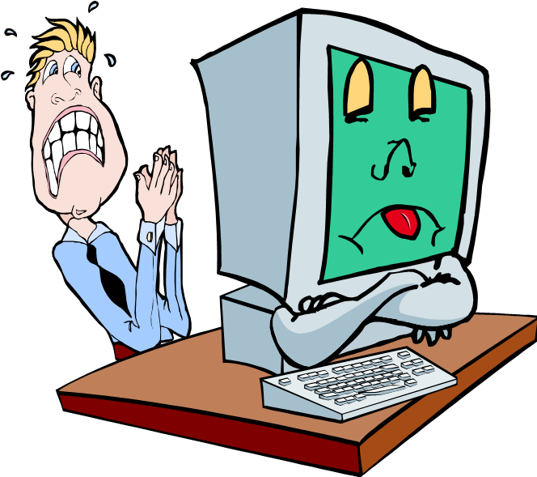

Slide 11
Self Care Secret #1
Using the
Right Tools!

Slide 14
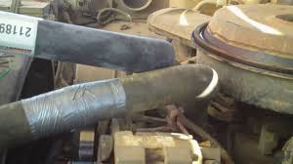
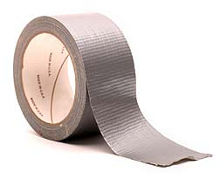
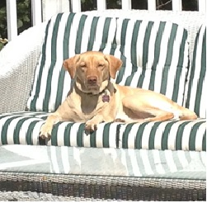


Slide 15
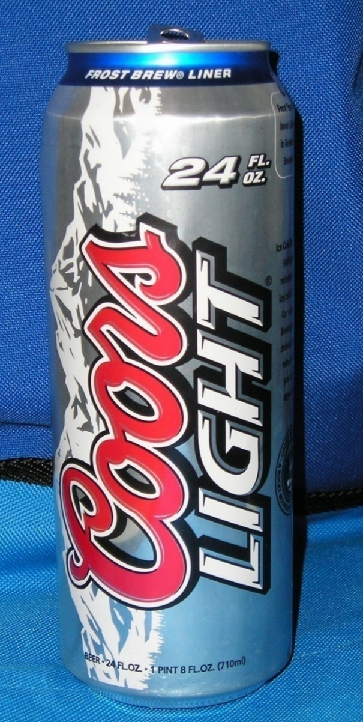
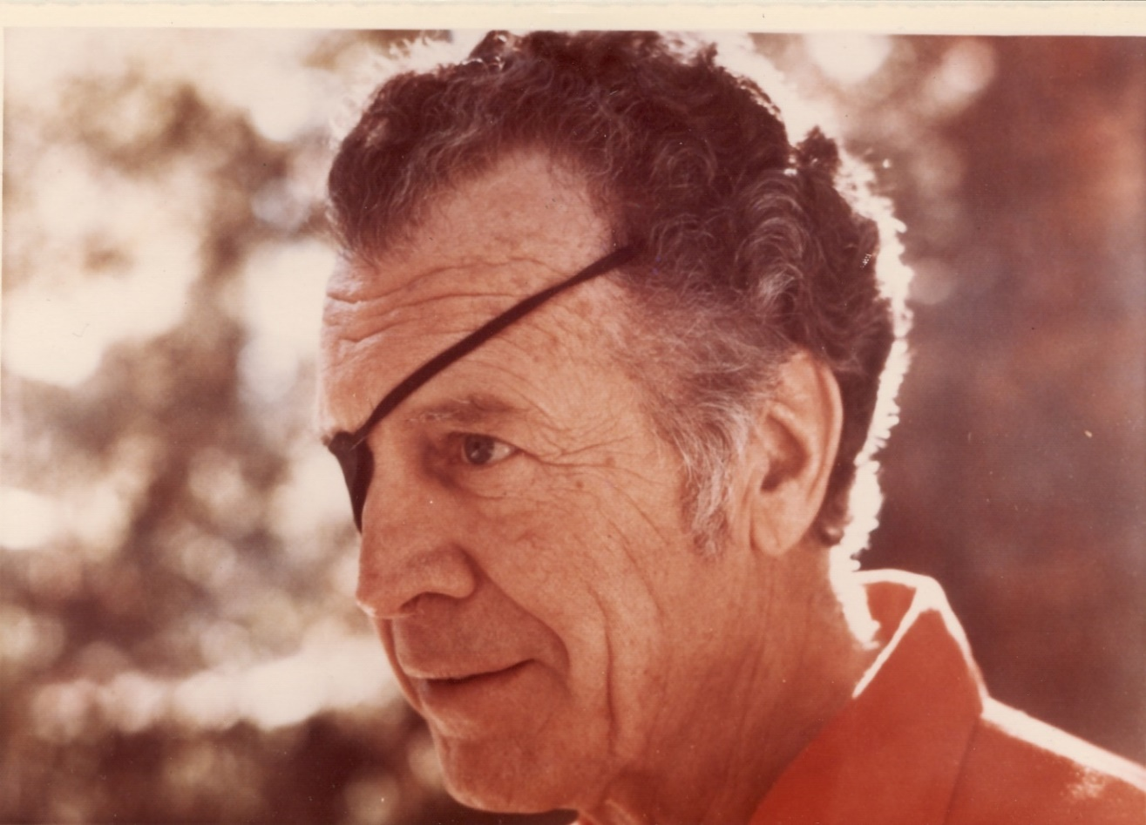
14 years old….

Slide 16
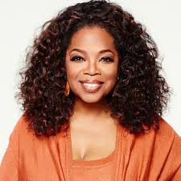

Slide 17
Beware!
EATING / FOOD
Shopping / Spending
Drinking
Smoking More
Caretaking
Working
Cell Phones
Avoiding
Using Substances
Complaining

Slide 18

Comfort
Zones!
FEAR

Slide 19

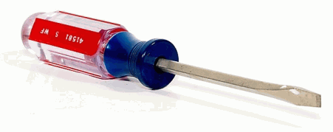
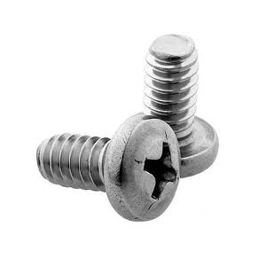
X
Right Tools Success!

Slide 20
?
Any
‘s

Slide 21
Self Care Secret #2
Managing
Stress!

Slide 22
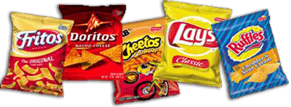
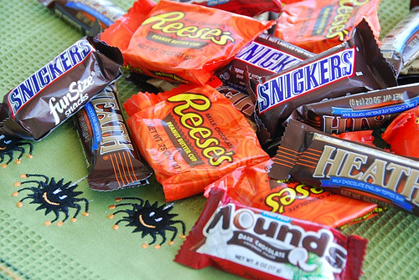
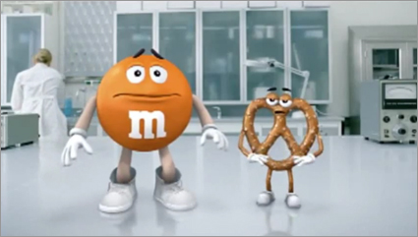
SALTY
SWEET
BOTH!

Slide 23


Slide 25
Critical Points:
It DOESN’T go anywhere on it’s own
It STAYS there until we release it
It’s The Same With Stress!

Slide 26
Rapid Release
Stress System
TM

Slide 27

DO60
Step 1 -
the level from rising!
(Passive)

Slide 29
DO60
Step 1 -
the level from rising!
(Passive)
Step 2 -
so the level drops!
(ACTIVE)

Slide 30


Slide 31
Passive
= Active
=
CALMING
Prayer
Count to 10
Time Out
Listen to Music
Breathing
Guided Imagery
Meditate
Serenity Prayer
Read
Shower or bath
Aromatherapy
+ Self Talk
Talk
Walk
Write
Sing / dance
Clean
Exercise
Coloring
Punching bag
Hobbies
Laughter
Gardening
Ho,Ho, Ha, Ha

Slide 32
Step 1
Step 2

Slide 33



The Quick 3 to STOP!
Breathing
+ Self Talk
Serenity Prayer

Slide 34
The Quick 3 to RELEASE!
You write…
DON’T read it -
DESTROY IT!
Dump
‘n
Destroy
Walk
Talk
Write

Slide 35
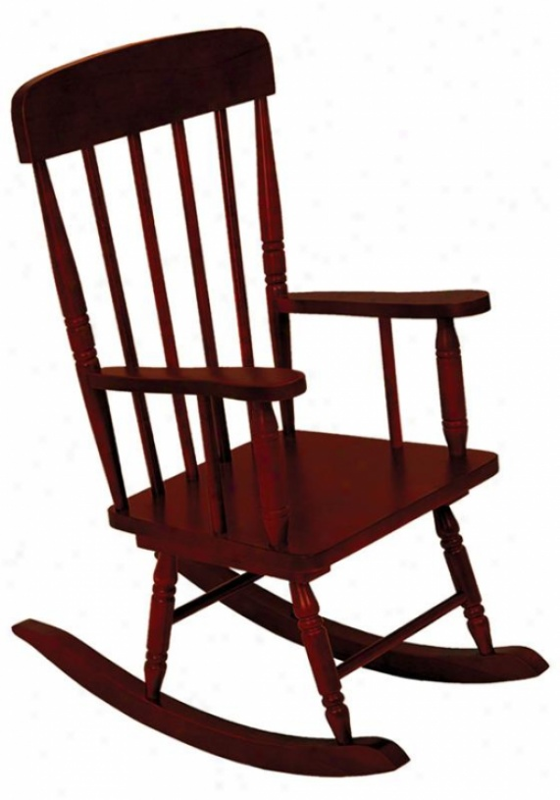
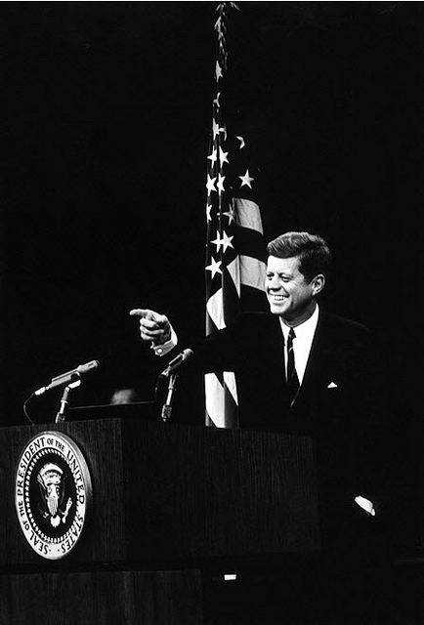

Slide 36
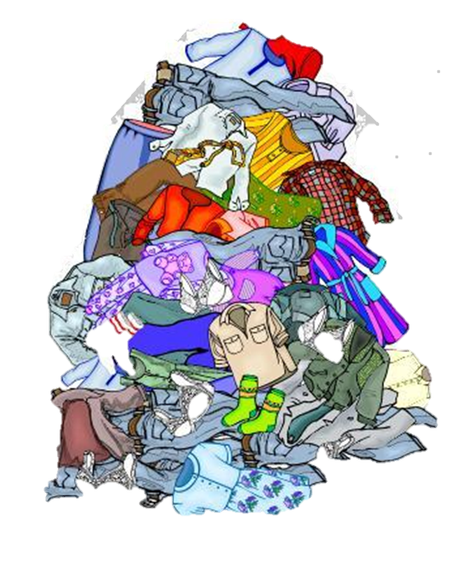

Slide 38
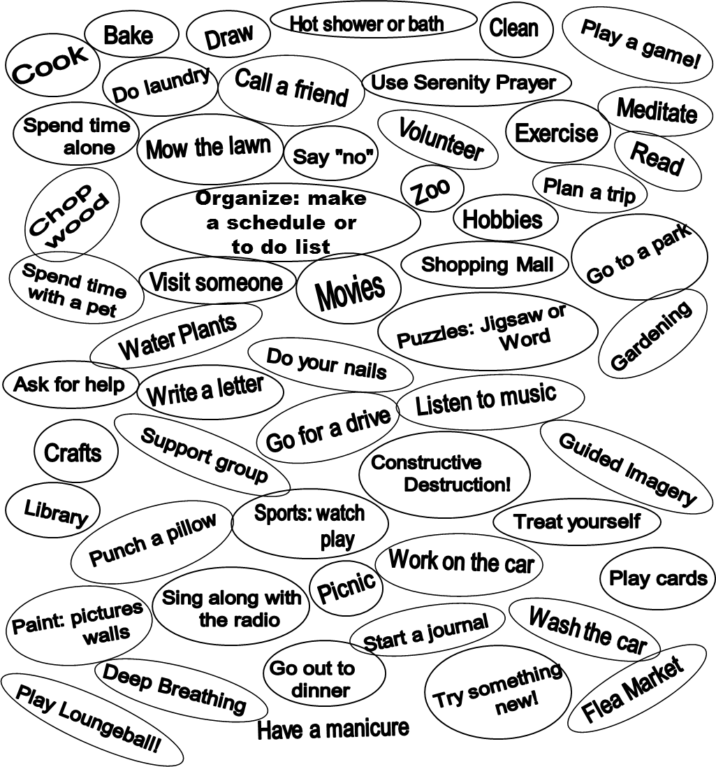

Slide 39
If It Doesn’t Involve You
Don’t Get Involved!

Slide 40
The
Only
Day
Afforded
You!

Slide 41
?
Any
‘s

Slide 42
Self Care Secret #3
Having A Solid Foundation

Slide 44

Imagine….

Slide 45
The secret to keeping your one car running?
Self Care!

Slide 46
L.I.F.E.
Self - Care
Blueprint

Slide 47


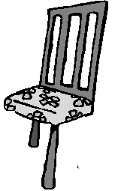


Slide 48

Solid
Stable
Sturdy

Slide 49
Self Care
STRESS!

Slide 50
Still have enough left!
Lost Some!

Slide 51
Self-Care
NU T R I T I ON
L
I
F
E
T
O
O
L
S
EXERC I S E
S
T
R
U
C
T
U
R
E

Slide 52
The Remaining Foundation
Self-Care
M E D I C A L
SUPPORT
A
C
C
E
P
T
A
N
C
E

Slide 53
It happened to Sarah…..

Slide 54
Self-Care
NU T R I T I ON
M E D I C A L
L
I
F
E
T
O
O
L
S
SUPPORT
EXERC I S E
A
C
C
E
P
T
A
N
C
E
S
T
R
U
C
T
U
R
E

Slide 55
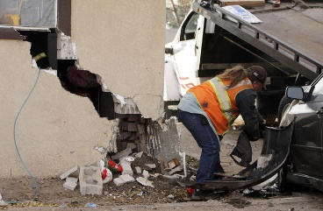

Slide 56
Self-Care
NU T R I T I ON
M E D I C A L
L
I
F
E
T
O
O
L
S
SUPPORT
EXERC I S E
A
C
C
E
P
T
A
N
C
E

Slide 57
Self-Care
NU T R I T I ON
M E D I C A L
SUPPORT
A
C
C
E
P
T
A
N
C
E

Slide 58
Sarah
HOSPITALIZED

Slide 59
The BIG Picture!
Self-Care
NU T R I T I ON
M E D I C A L
L
I
F
E
T
O
O
L
S
SUPPORT
EXERC I S E
A
C
C
E
P
T
A
N
C
E
S
T
R
U
C
T
U
R
E

Slide 60
My Picture – Health Issues!
Self-Care
M E D I C A L
NU T R I T I ON
L
I
F
E
T
O
O
L
S
SUPPORT
EXERC I S E
A
C
C
E
P
T
A
N
C
E
S
T
R
U
C
T
U
R
E

Slide 61
Building Process
Self-Care
NU T R I T I ON
M E D I C A L
L
I
F
E
T
O
O
L
S
SUPPORT
EXERC I S E
A
C
C
E
P
T
A
N
C
E
S
T
R
U
C
T
U
R
E

Slide 62


Small change adds up to BIG CHANGE!

Slide 63
?
Any
‘s

Slide 64


Self Care Secret #1:
Using The Right Tools
The quick fixes become the PROBLEM!

Slide 65
Self Care Secret #2:
Managing Stress!
Step 1 - STOP!
DO60
Step 2 - RELEASE!

Slide 66
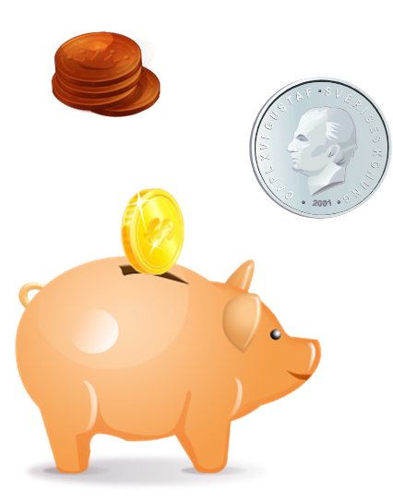
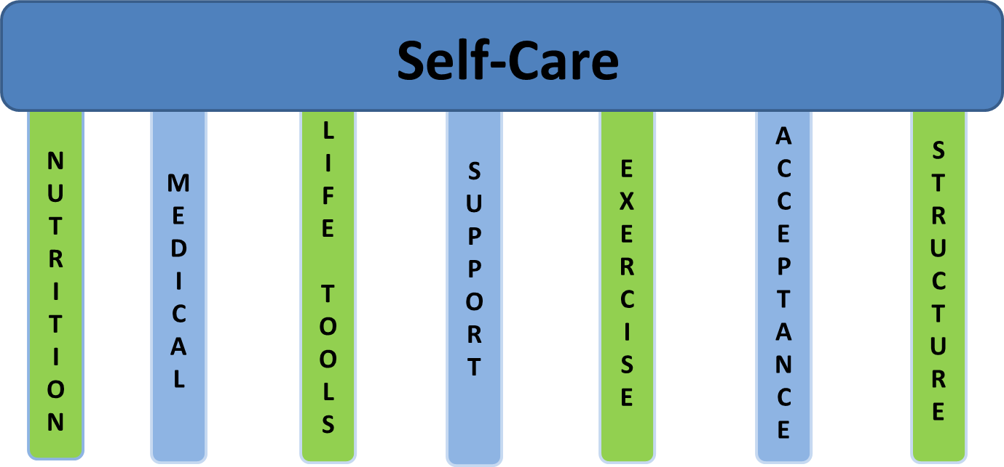



Self Care Secret #3:
Having a Solid Foundation

Slide 67


Slide 68
Carol L Rickard, LCSW
You can reach me:
Phone: 888 LifeTools
Email: Carol@WellYOUniversity.com
Books: amazon.com/author/carolrickard

Slide 69
Thank You!

Slide 70
Leave
Everything
To
God’s
Ownership!
Taken from:
“WordTools”

Slide 71
Magnificent
Instrument
Needing
Direction!
Taken from:
“WordTools”

Slide 72
S
T
R
+
=
Situation
Thoughts
Response

